Slide 1

User friendly cross-platform
3D particle tracking velocimetry
Renewable Energy & Turbulent Environment Group
Department of Mechanical Science and Engineering
University of Illinois at Urbana-Champaign
Renewable Energy & Turbulent Environment Group
U N I V E R S I T Y OF I L L I N O I S AT U R B A N A – C H A M P A I G N

Slide 2
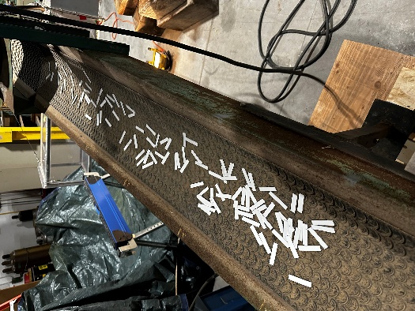
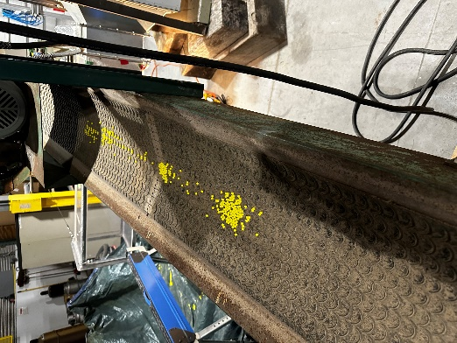
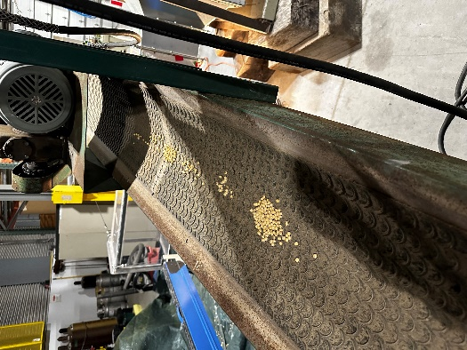
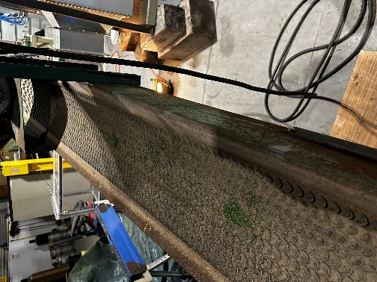
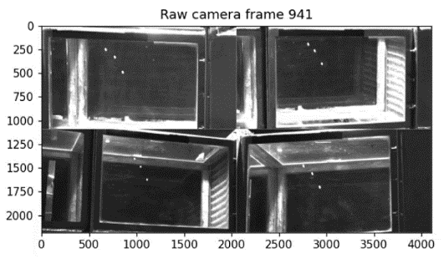
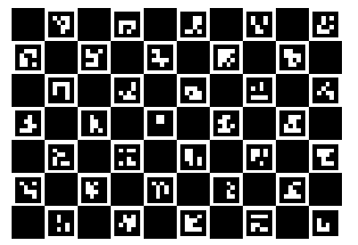
Experiments at Mouline
Particle types:
Plastic spheres
Beans
Grass
3D printed plastic rectangular piece
Cases:
Single particle
Three particle
Many particles (50 ~ 200)
PTV mode:
3D PTV with 4 cameras
2D PTV with single camera
Calibration target: Charuco board
Renewable Energy & Turbulent Environment Group
U N I V E R S I T Y OF I L L I N O I S AT U R B A N A – C H A M P A I G N

Slide 3
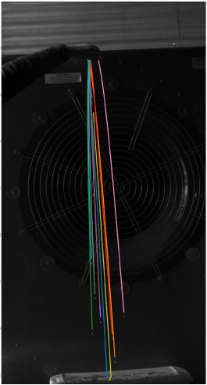
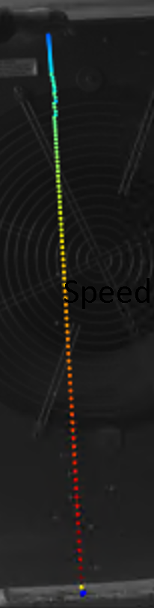
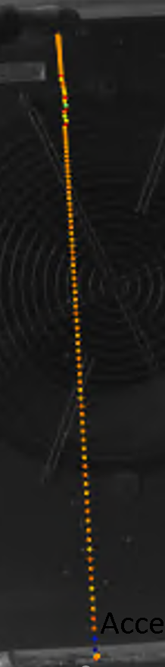

2D PTV of free fall particles
U/U_{max}
1.0
0.5
0
a/g = 1
Speed, U
Acceleration, a
Example of a selected trajectory.
Velocity and acceleration.
Particle trajectories
Color indicates different particles
Renewable Energy & Turbulent Environment Group
U N I V E R S I T Y OF I L L I N O I S AT U R B A N A – C H A M P A I G N

Slide 4
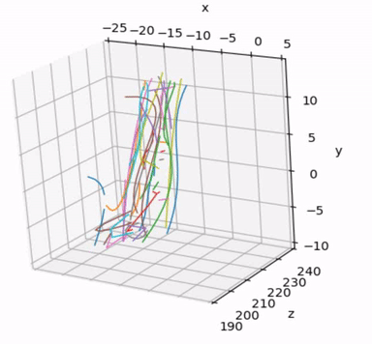
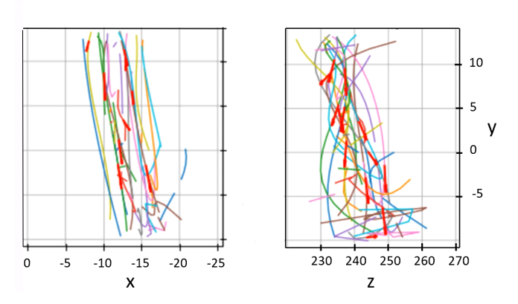
3D PTV for spherical target tracking
3D view
x-y view
y-z view
The red vector, which indicates the velocity of particles, is visible in that frame.
The right part of the video displays the 2D-2D particle matching for the corresponding frames.
Renewable Energy & Turbulent Environment Group
U N I V E R S I T Y OF I L L I N O I S AT U R B A N A – C H A M P A I G N

Slide 5
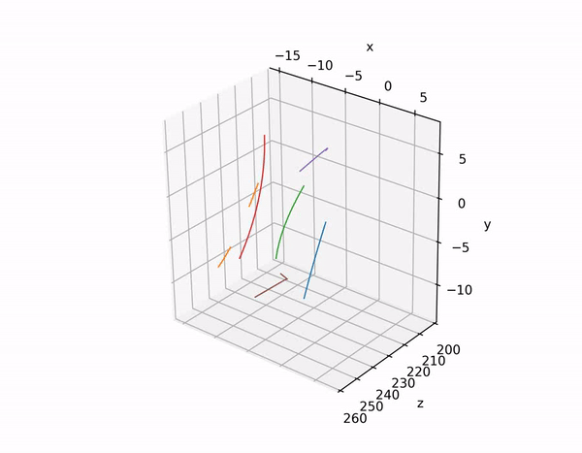
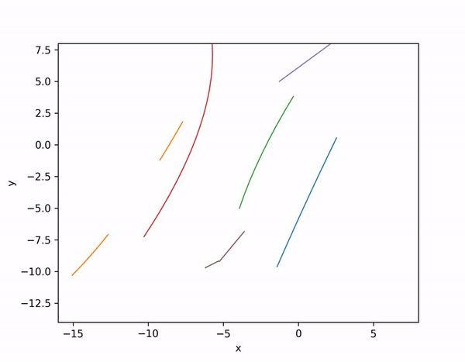
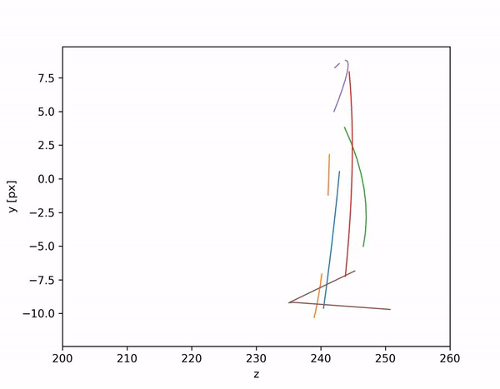
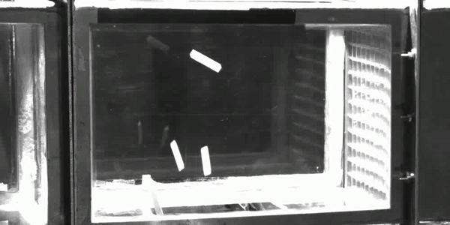
3D PTV for 3D printed plastic rectangular piece
x-y view
y-z view
3D view
Because the target has a rectangular shape, it appears relatively large compared to the small investigation volume, high density making it difficult to distinguish and match them from different views. The targets' projections are overlapping, and we are currently using line detection to separate them (maybe we shouldn’t mention)
4 pieces tracking
Renewable Energy & Turbulent Environment Group
U N I V E R S I T Y OF I L L I N O I S AT U R B A N A – C H A M P A I G N

Slide 6
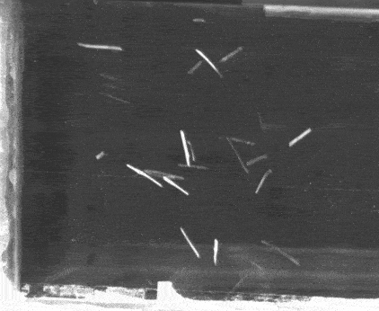
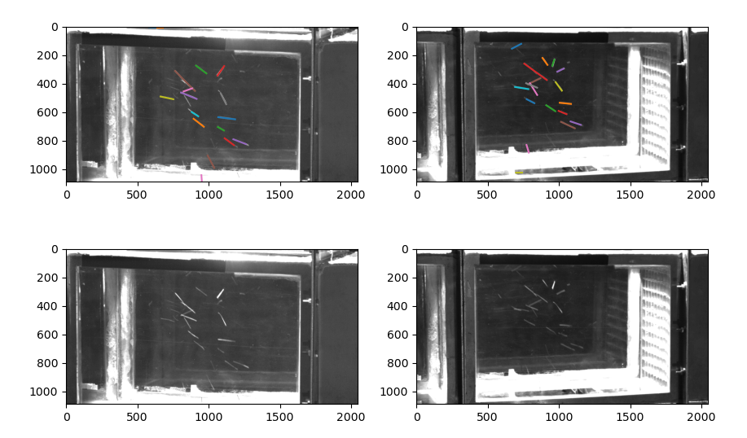
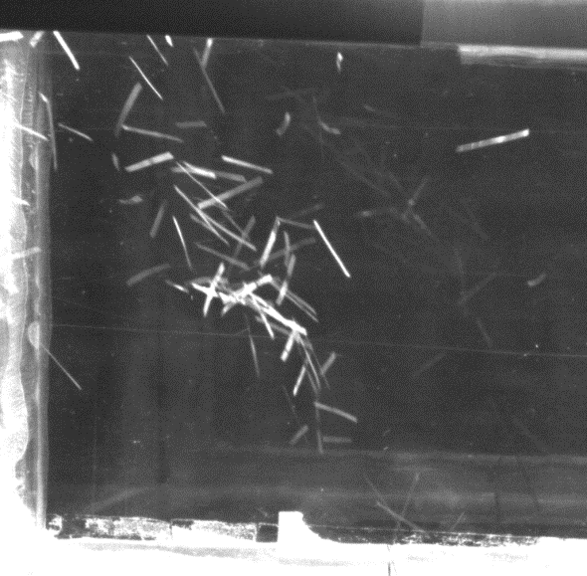
3D PTV for grass
…
Maximum density we can track
Grass detected view 1
Grass detected view 2
…
View 1
View 2
OSTU threshold method used for preprocessing.
Hough transform used for edge detection.
K cluster mean method to label each grass.
Too dense to track
Renewable Energy & Turbulent Environment Group
U N I V E R S I T Y OF I L L I N O I S AT U R B A N A – C H A M P A I G N

Slide 7
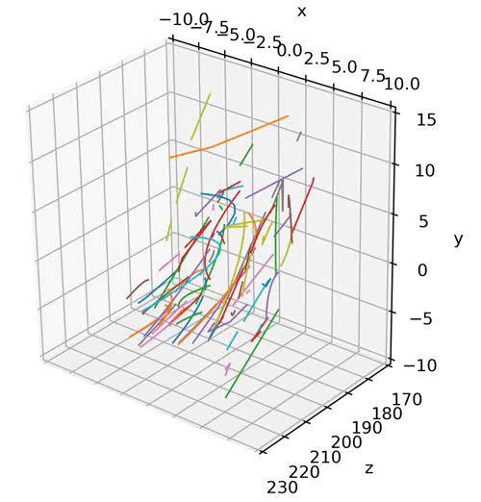
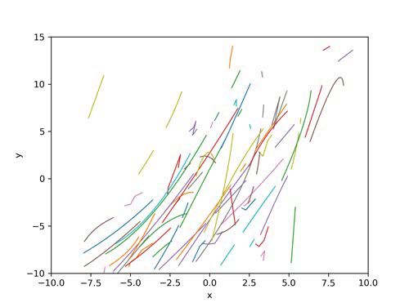
3D PTV for grass
x-y view
3D view
Renewable Energy & Turbulent Environment Group
U N I V E R S I T Y OF I L L I N O I S AT U R B A N A – C H A M P A I G N

Slide 8
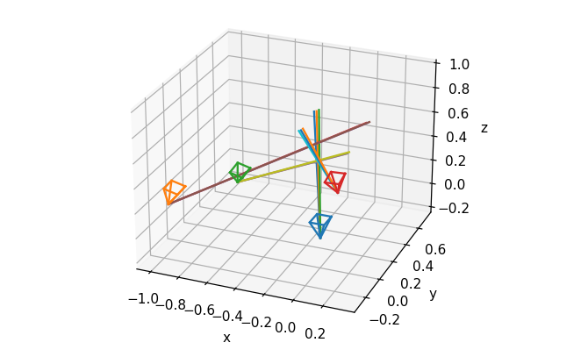
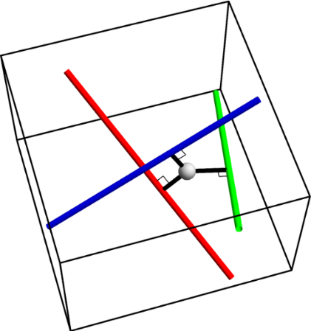
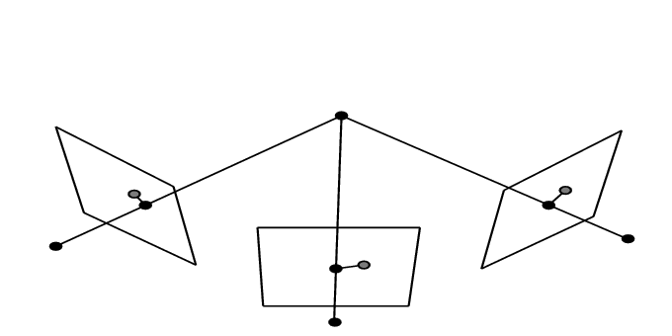
Large particle in small volume
DLT algorithm(we previously used) is that it can be sensitive to variations, calibration, unsynchronized camera and error of center detection.
Relays on converge of 4 rays, which mean small delay in one of 4 camera can destroy the tracking, especially when FOV is small.
Delay appears in Mouline’s experiment and large particle in small volume tracking is uncommon for PTV. How to make the system more robust under error from delays and center detection?
No delay example
Renewable Energy & Turbulent Environment Group
U N I V E R S I T Y OF I L L I N O I S AT U R B A N A – C H A M P A I G N
Notes:
MLA is placed in the intermediate plane between tube lens and camera sensor.
Each lenslet can be regarded as pin hole camera model.
Red lines indicates rays from in focused particle, green lines show rays from out of focused particle.

Slide 9
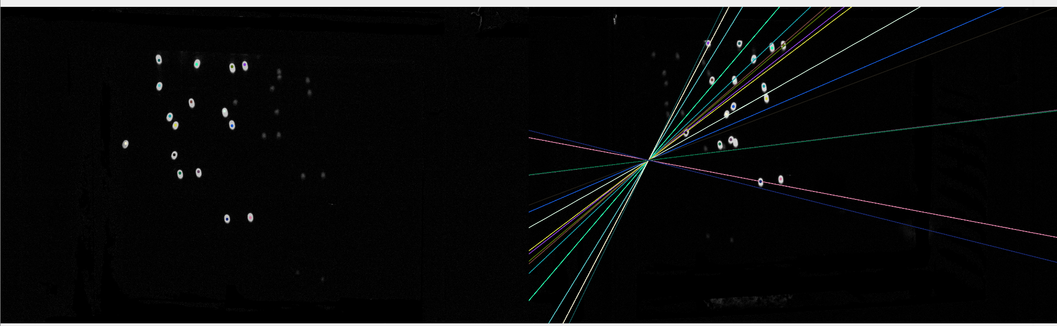
Modified epipolar searching mixed with homography finder
Generate epipolar line corresponding to particle in camera 1.
Search along epipolar line in camera 2,3,4.
3. Since there is delay, sometimes the particle won’t be very close to epipolar line.
4. Use epipolar line combined with homography finder method to search for potential particle.
Although this function has been migrated from openptv, simply using epipolar searching is insufficient to match all points across views due to minor delays.
Renewable Energy & Turbulent Environment Group
U N I V E R S I T Y OF I L L I N O I S AT U R B A N A – C H A M P A I G N

Slide 10
Modified epipolar searching mixed with homography finder
Regard the particle in 3D position as a rigid body.
Since delay the rigid body size and shape is slightly changed and modified.
Iterative Closest Point algorithm used to fine tune the coordinates to match 2d particle projection.
Calculate homography mapping matrix between each pair of camera.
Run coarse mapping with ransac filter.
Run dense mapping based on homography mapping matrixing.
Renewable Energy & Turbulent Environment Group
U N I V E R S I T Y OF I L L I N O I S AT U R B A N A – C H A M P A I G N

Slide 11
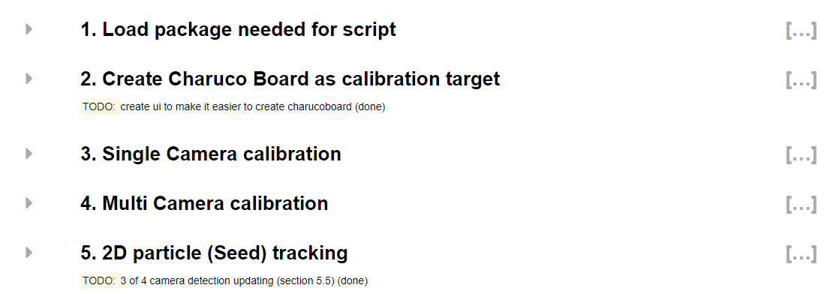
User interface design: Overview
5 steps
Step1: simple import wrapped program
Renewable Energy & Turbulent Environment Group
U N I V E R S I T Y OF I L L I N O I S AT U R B A N A – C H A M P A I G N

Slide 12
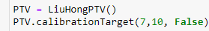
User interface design: step 2
Create calibration board & print it
Renewable Energy & Turbulent Environment Group
U N I V E R S I T Y OF I L L I N O I S AT U R B A N A – C H A M P A I G N

Slide 13
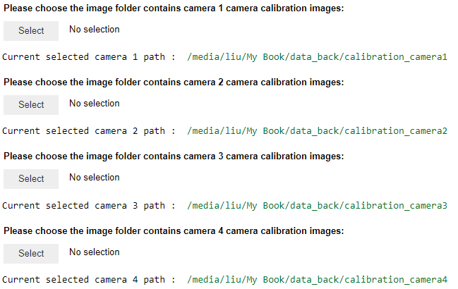
User interface design: step 3
Calibration each lens parameter: focal length, distortion and so on.
Folder selection UI for easy calibration folder selection.
Renewable Energy & Turbulent Environment Group
U N I V E R S I T Y OF I L L I N O I S AT U R B A N A – C H A M P A I G N

Slide 14
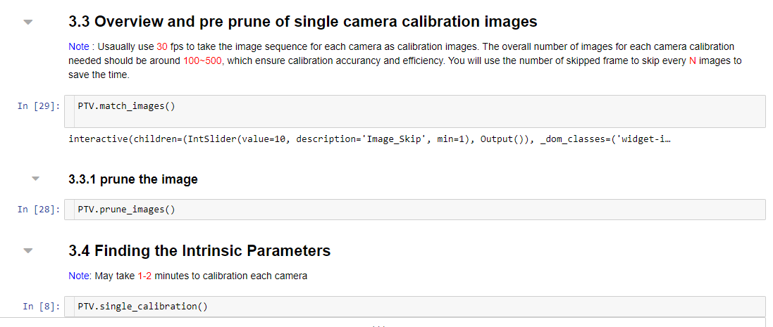
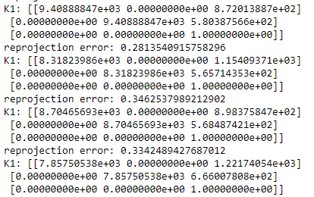
User interface design: step 3
3 lines code easy lens calibration.
Calibration result automatic backup for repeated use.
Renewable Energy & Turbulent Environment Group
U N I V E R S I T Y OF I L L I N O I S AT U R B A N A – C H A M P A I G N

Slide 15
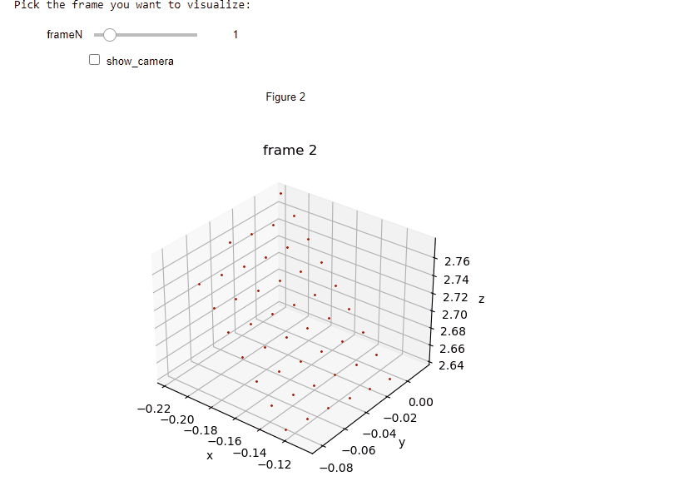
User interface design: step 4
5 lines code for fast multi camera calibration.
User interface to visualize the camera calibration result with calibration board detection.
Renewable Energy & Turbulent Environment Group
U N I V E R S I T Y OF I L L I N O I S AT U R B A N A – C H A M P A I G N

Slide 16
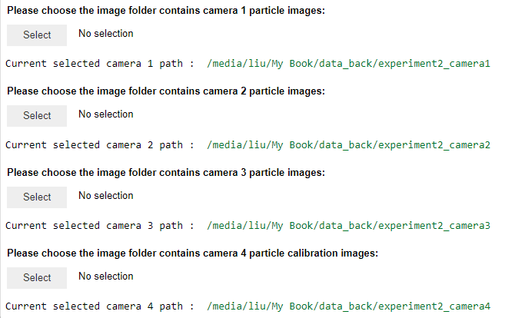
User interface design: step 5
Data folder selection UI.
Renewable Energy & Turbulent Environment Group
U N I V E R S I T Y OF I L L I N O I S AT U R B A N A – C H A M P A I G N

Slide 17
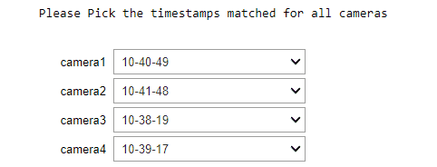
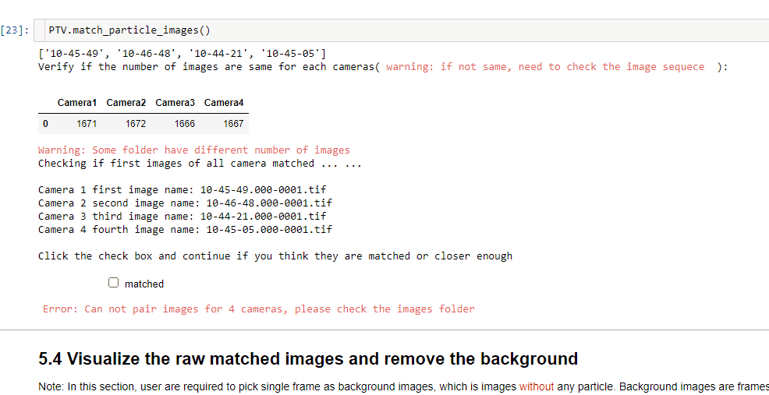
User interface design: step 5
Synchronization checker UI for name matching.
Synchronization checker UI for image index matching: automatic prune image sequences
Renewable Energy & Turbulent Environment Group
U N I V E R S I T Y OF I L L I N O I S AT U R B A N A – C H A M P A I G N

Slide 18
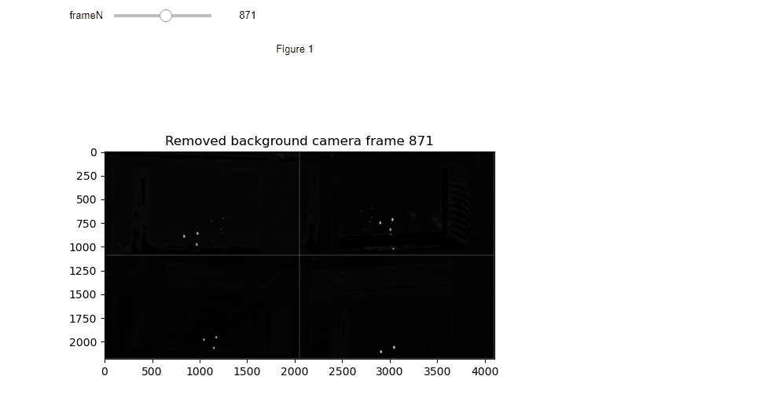
User interface design: step 5
Preprocessing: background remove UI
Renewable Energy & Turbulent Environment Group
U N I V E R S I T Y OF I L L I N O I S AT U R B A N A – C H A M P A I G N

Slide 19
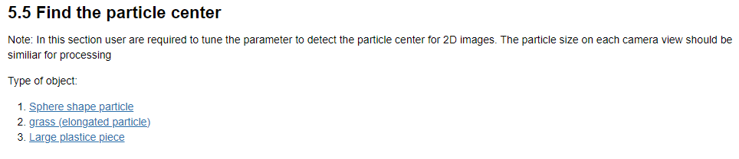
User interface design: step 5
Preprocessing: particle detector tuning UI for 3 type of objects with hyperlink.
Renewable Energy & Turbulent Environment Group
U N I V E R S I T Y OF I L L I N O I S AT U R B A N A – C H A M P A I G N

Slide 20
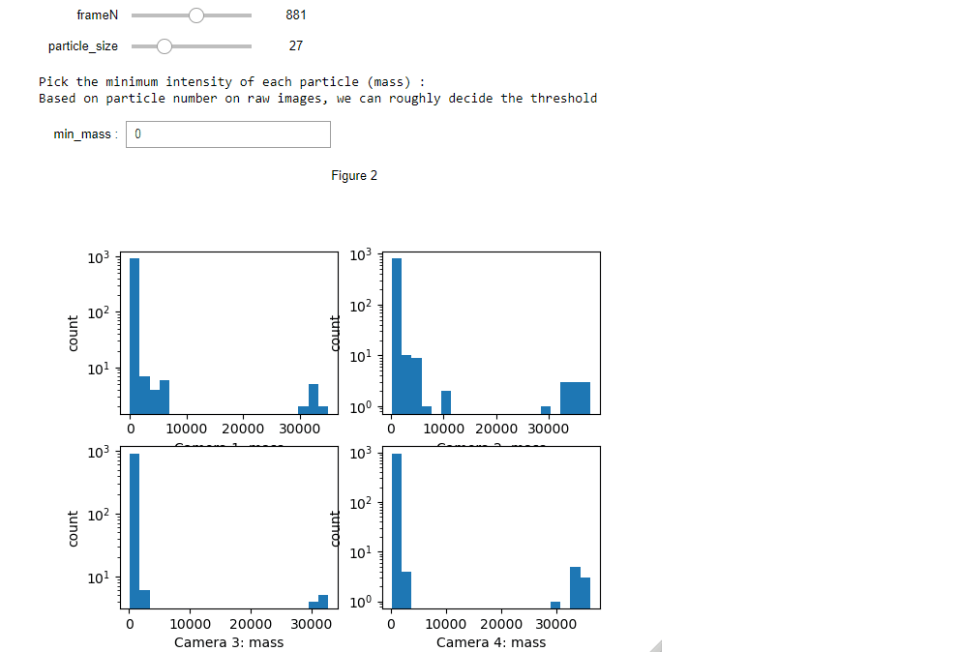
User interface design: step 5
Preprocessing: particle detector tuning UI for 3 type of objects with hyperlink.
Renewable Energy & Turbulent Environment Group
U N I V E R S I T Y OF I L L I N O I S AT U R B A N A – C H A M P A I G N

Slide 21
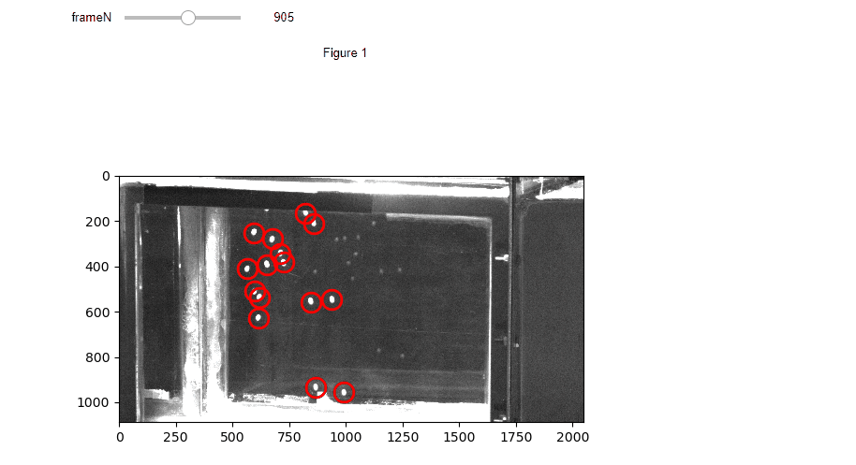
User interface design: step 5
Preprocessing: 2D detection visualization UI.
Renewable Energy & Turbulent Environment Group
U N I V E R S I T Y OF I L L I N O I S AT U R B A N A – C H A M P A I G N

Slide 22
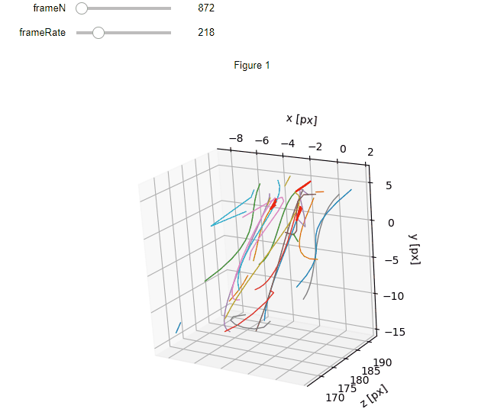
User interface design: step 5
Processing: 3D tracking loading interface.
Postprocessing : 3D trajectories and velocity visualization.
Renewable Energy & Turbulent Environment Group
U N I V E R S I T Y OF I L L I N O I S AT U R B A N A – C H A M P A I G N

